Slide 1
Digital Input To Tactile Feedback
Project Stage-I (ECP455) SEM: VII
Team Members:
Arya Dongre (A2 - 03)
Amit Vishwakarma (A2 - 14)
Mayank Mundhada (A2-23)
Mohammad Kaif Raza (A2-24)
Guide: Dr. P.P. Deshpande
Session 2024-25
Department of Electronics & Communication Engineering

Slide 2
Contents
Introduction & Objectives
Literature Survey
Proposed Method
Feasibility Analysis
Impact or Usefulness of the Solution
Conclusion
References

Slide 3
Introduction
Problem Statement:
Individuals with visual impairments encounter significant challenges in accessing affordable, user-friendly Braille education tools. Existing solutions are often high-cost and mechanically intricate, limiting accessibility. This project proposes the development of a compact, energy-efficient, and cost-effective Braille learning device that translates digital text into tactile feedback using a simplified motor-actuated system. By prioritizing ergonomic design and reduced power consumption, the device offers an accessible solution that enhances Braille literacy and digital text accessibility for the visually impaired

Slide 4
Objectives
Creating a system to convert digital text to tactile feedback
Implementing a system that reads data in txt format and translates the content in real time using servo actuated braille dots
Reading and writing data in txt format using SPIFFS
Sequentially translate characters to braille for easy reading

Slide 5
Literature Survey
Sr. No | Paper/Patent Title or other literature referred | Patent No./ISBN No. | Remarks
1. | Smart Interactive System for Braille Learning | AU2022218635B2 | A smart, interactive Braille learning system with tactile feedback, audio, and internet connectivity for remote updates and tracking.
2. | Electromagnetic Solenoid Actuator | EP1265259A1 | An electromagnetic solenoid actuator with a position-limiting mechanism that adjusts the operation rod's position based on electric power input

Slide 6
Proposed Method
System Overview: Read txt files from SPIFFS using ESP32, maps characters to braille patterns using 3 servo motors to actuate braille dots
Component Setup:
- ESP32: Central controller for motor control
- Three servos: Each controlling two actuators with a shaft to represent Braille dots.
Data Transfer:
- Reads txt file stored in SPIFFS for local data retrieval
Mapping:
- Map characters in the txt file to braille patterns
Motor Control:
- Develop an algorithm for simultaneous servo actuation based on Braille character mappings.

Slide 7
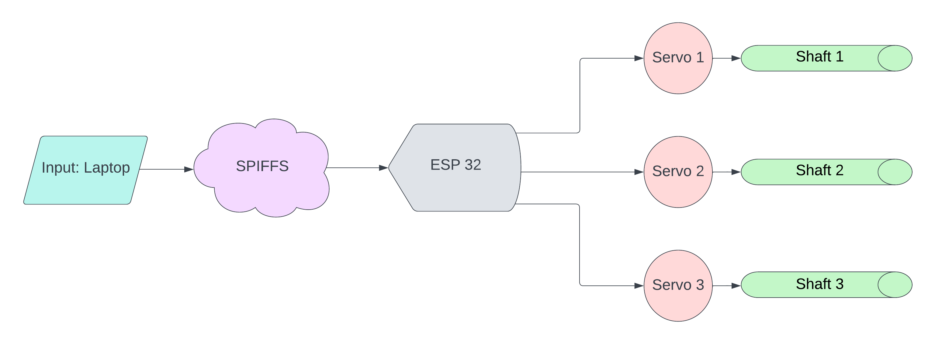
Block Diagram
Figure 1: Block Diagram

Slide 8
Proposed Solution
Real-Time Translation: The system translates txt file into Braille in real-time dynamic feedback, allowing users to read documents letter by letter.
Accurate Actuation: Three servo motors are controlled via PWM signals to accurately represent braille dots.
Compact Design: Utilizes ESP 32 with SPIFFS for local text storage, reducing the need for additional components.
Cost-Effective and Accessible: Utilizing common components makes the system affordable and easier to reproduce, increasing accessibility for visually impaired individuals.

Slide 9
Feasibility Analysis
Technical – Uses available components, moderate complexity with existing supporting development.
Economic – Low cost components compared to traditional braille devices.
Operational – User Friendly with minimal maintenance required, portable.
Market – Strong demand in assistive technology, suitable for visually impaired and educational institutes

Slide 10
Impact or Usefulness Of the Project
1. Impact of project on Societal issues
- Accessibility & Educational Challenges
- Economic Disparity in Assistive Devices
- Social Exclusion of Visually Impaired
2. Impact of project on Environmental issues:
- Reduction in Paper Usage
- Energy Efficiency
- Electronic Waste Minimization
- Sustainable Design

Slide 11
Conclusion
Improved Accessibility: The project successfully bridges the gap between digital content and Braille, offering visually impaired individuals a practical and affordable solution to read digital files.
Cost-effective and Scalable: Using low-cost components like ESP32, servo motors, this project presents an economical alternative to expensive Braille devices, making it accessible to a wider audience.
Educational and Societal Impact: This project has the potential to make education more inclusive, while also contributing to the social empowerment of visually impaired individuals by providing them with greater access to information and opportunities.
Potential for Future Expansion: The design can be further enhanced by incorporating more advanced features, such as cloud storage, real-time document sharing, or multi-language support, increasing its utility and functionality.

Slide 12
References
[1] Sanskriti Atul Dawale, “A Smart interactive System for Braille Learning”, AU2022218635B2, Jan 11,2024, https://patents.google.com/patent/AU2022218635B2/en?q=(Braille+haptic+feedback)&oq=Braille+haptic+feedback
[2] Yang Xiaohui, “Braille Learning Machine”, CN102881195B, Aug 06, 2014, CN102881195B - Braille learning machine - Google Patents
[3] Nanami Haga, “Wearable Braille Reader”, presented at the IEEE GCCE, Kyoto Japan, https://doi.org/10.1109/GCCE53005.2021.9622028 , Dec 1, 2021.
[4] Alexander Russamanno, “Refreshing Refreshable Braille Displays”, presented at the IEEE Transactions on Haptics, Refreshing Refreshable Braille Displays | IEEE Journals & Magazine | IEEE Xplore, April 15, 2015.

Slide 13
References
[5] “How the Braille Alphabet Works”, https://www.perkins.org/how-the-braille-alphabet-works/
[6] ”Braille-Translator”, GitHub. https://github.com/LazoCoder/Braille-Translator
[7] ”Braille Authority of North America”. BANA. https://www.brailleauthority.org/ueb/symbols_list.pdf
[8] “ThinkerBell Labs”. https://www.thinkerbelllabs.com/

